Slide 1


Nonlinear Mixed Effects Modelling with Pumas.jl
Vaibhav Kumar Dixit
@Vaibhavdixit02

Slide 2
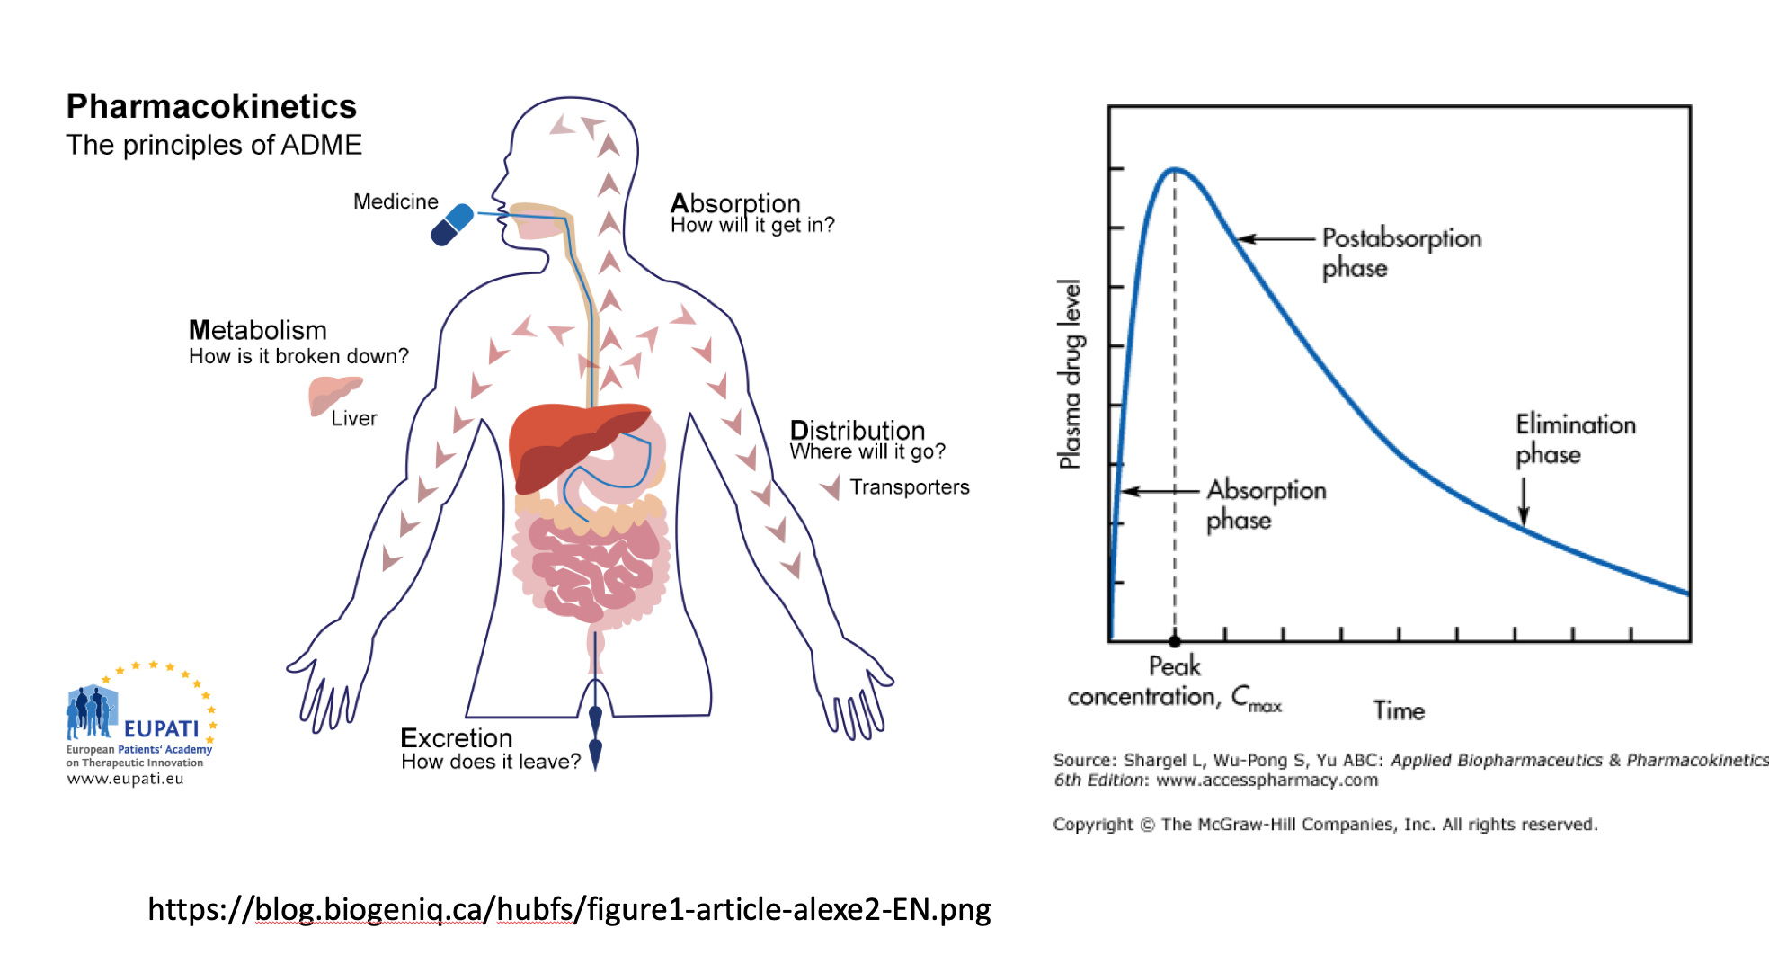
Notes:
When you take a drug, generally it is considered to pass through 4 steps, ADME.
The graph here describes the change in concentration of the drug in blood over time as it undergoes the steps.
Absorption: For the drug to have the desired effect it needs to reach the appropriate part of the body where it will act. This usually happens by the dissolution of the drug in the blood, this happens through absorption in digestive tract. In this step you see the increase in the level of the drug amount in the the blood.
Distribution: Once the drug is in the blood, it is then distributed to the muscles or organs that is its target. Because we are observing the amount of the drug in the blood, you start to see a decrease.
Excretion: The drug is then removed from the body. And the decrease continues.

Slide 3
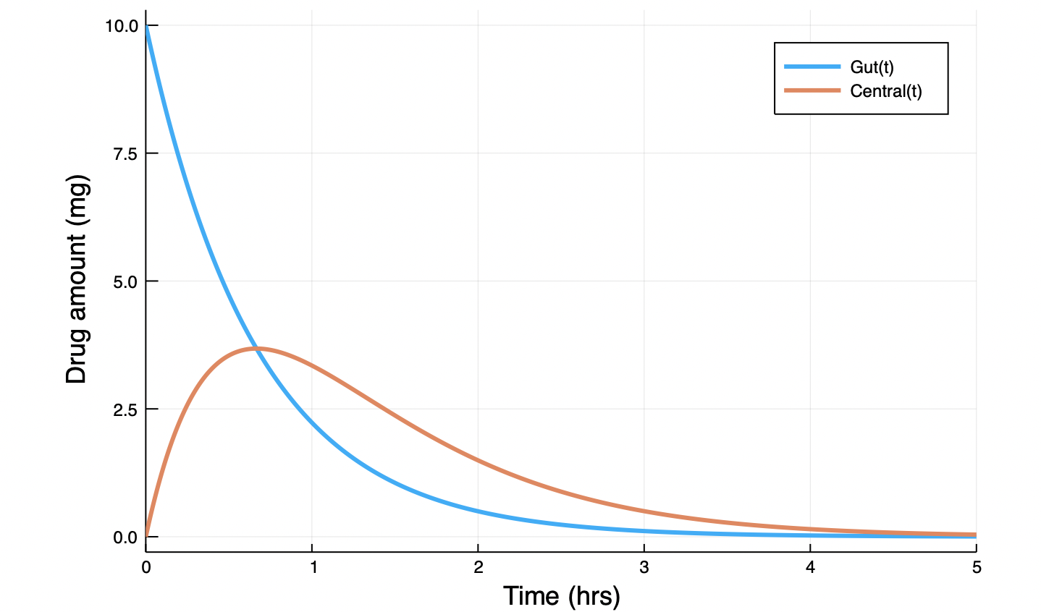
Modelling the drug amount in the body
$$\begin{matrix}\frac{dGut}{dt} & = & −Ka×Gut \\ \frac{dCentral}{dt} & = & Ka×Gut−\frac{CL}{V}×Central\end{matrix}$$
Notes:
The above equations represent a basic model of giving a dose of a drug to an individual and measuring the amount in two compartments over time, assuming the drug was given orally, they can be gut and the blood stream.

Slide 4
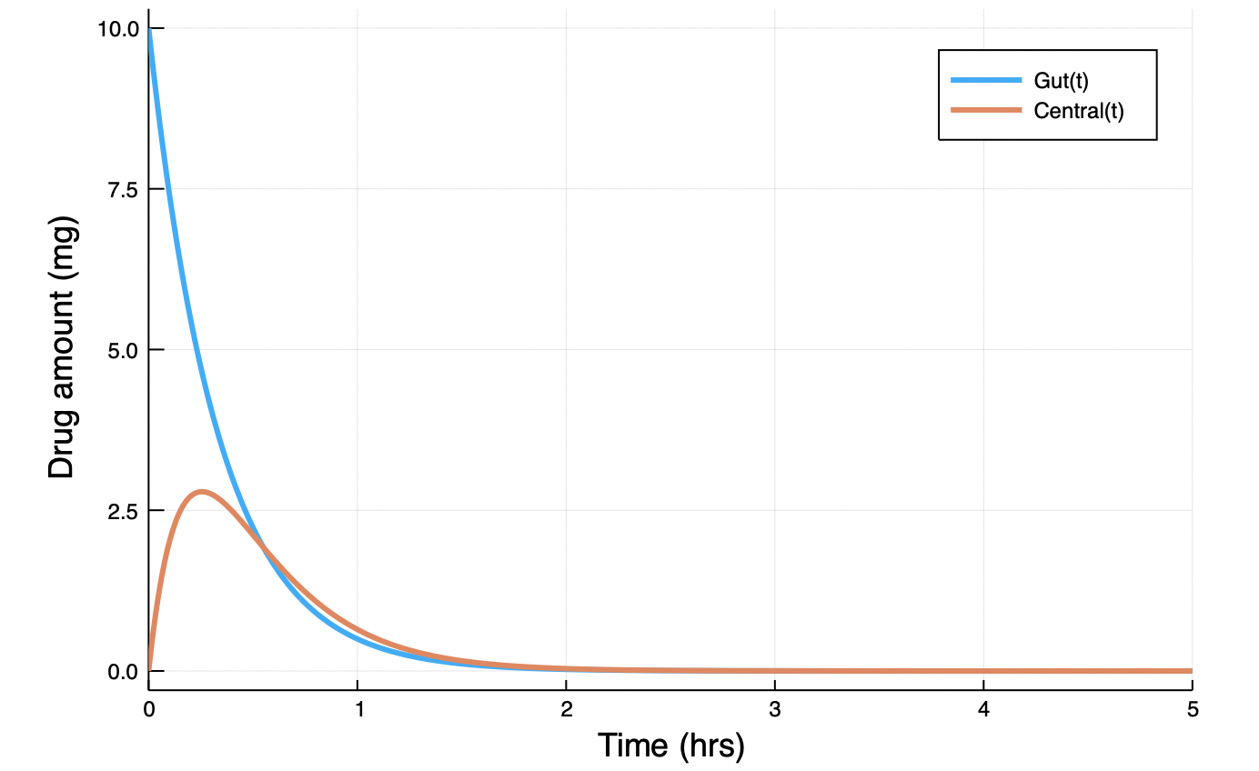
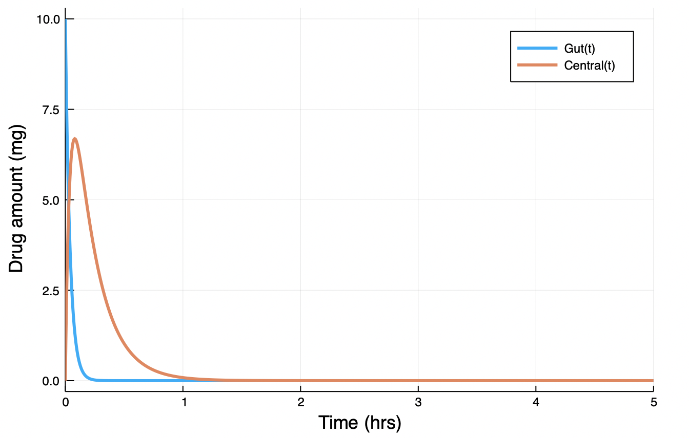
But the parameters?
Ka = 3
CL/V = 5
Ka = 25
CL/V = 5
Notes:
But the as you can see the profiles depend on the parameters as well, let’s say, two people have different volume of the stomach, that affects the rate of diffusion of the drug into the blood.

Slide 5
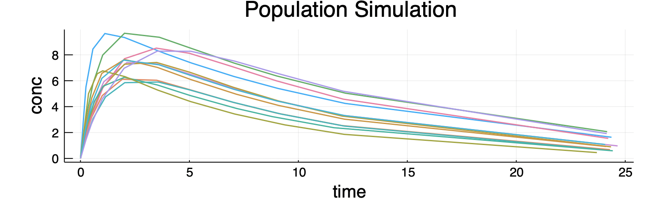
Moving from an individual to a population
So the same dose, same model, but different concentration profiles for different individuals because of the variation in the parameters that define a subject.
How do we capture this variability?
Notes:
Well, we use NLME models for this.

Slide 6
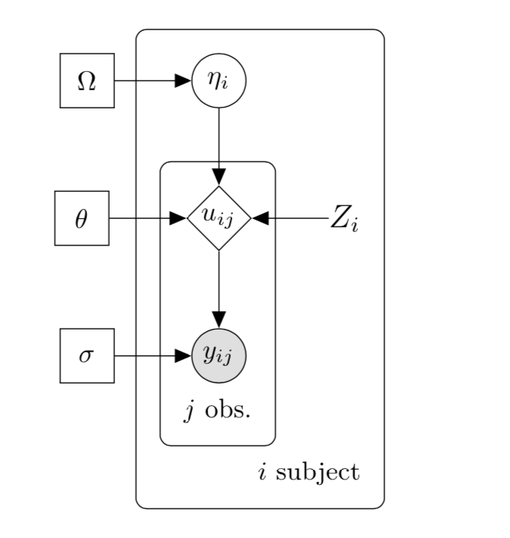
Non Linear Mixed Effects Models
Random Effects
Fixed effects
Covariates
Dynamics
Observations
Notes:
So we can use differential equations to model the dynamics of the model, this will give us a solution over time. These solutions are parametrised by the fixed effects, the subject specific covariates and the random effects.
Fixed effects are the parameters that are consistent across the population. Each of the subjects has the same values for these.
But something like the weight of the subjects in a population would probably vary, these are the Covariates.
Despite this there might still be some unexplained inter-individual variability (IIV) across the subjects, the random effects capture this. Now these combine in different ways to give us the parameters of our dynamics.
But the actual observed response variables are not just the solution of the dynamics. For that we add some error distribution which depends on uij (dynamics) and some additional parameter sigma.

Slide 7
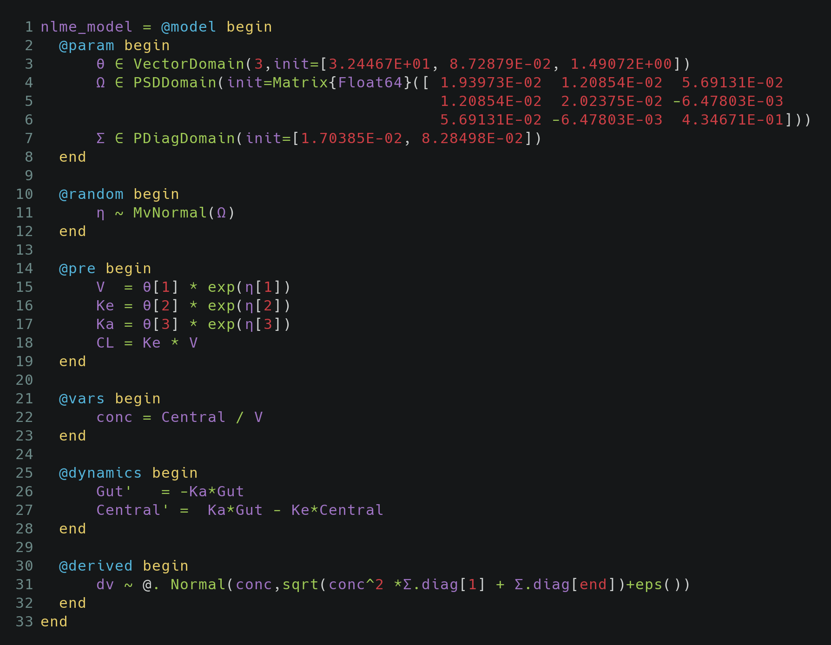
Defining NLME Models in Pumas
Notes:
We define a model with the @model macro. You’ll notice a block based interface for defining these models. Let’s try to understand what these blocks are doing individually.

Slide 8
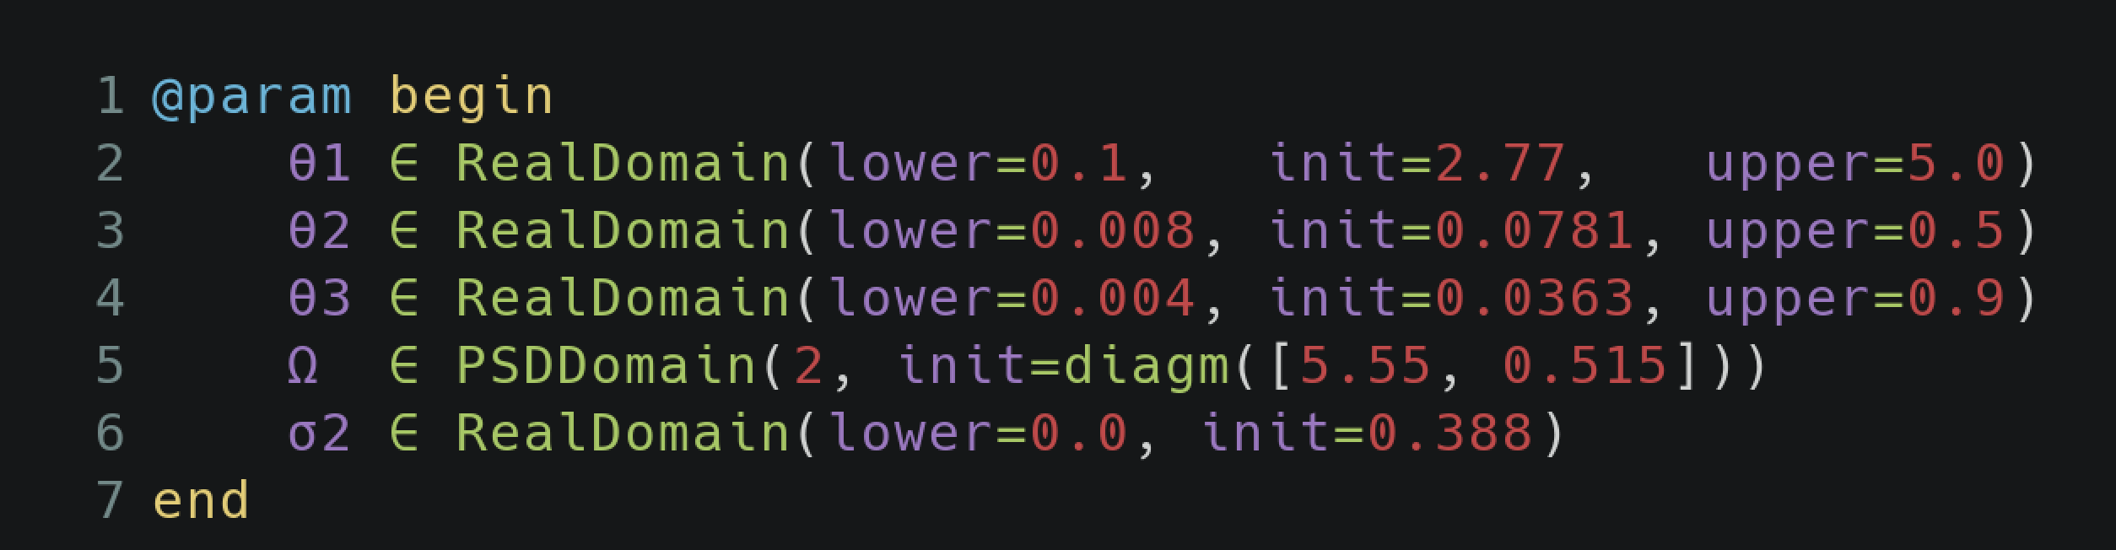
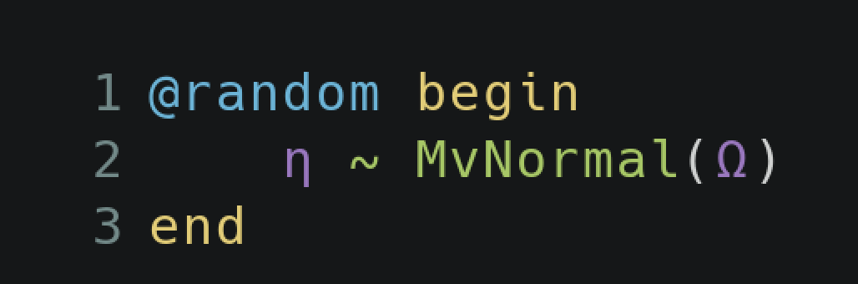
@param: Model parameters (Population averages)
@param begin
θ1 ∈ RealDomain(lower=0.1, init=2.77, upper=5.0)
θ2 ∈ RealDomain(lower=0.008, init=0.0781, upper=0.5)
θ3 ∈ RealDomain(lower=0.004, init=0.0363, upper=0.9)
Ω ∈ PSDDomain(2, init=diagm([5.55, 0.515]))
σ2 ∈ RealDomain(lower=0.0, init=0.388)
end
This specifies the parameters of the model, and their domains:
RealDomain: real values (possibly subject to upper/lower bounds)
VectorDomain: vector of real valies
PSDDomain: symmetric positive-definite matrices (e.g. for covariance matrices)
PDiagDomain: postive-valued diagonal matrices
@random: Random effects (Individual differences)
@random begin
η ~ MvNormal(Ω)
end
Specifies the random effects, dependent on parameters. The random effects are defined by a distribution from Distributions.jl.

Slide 9
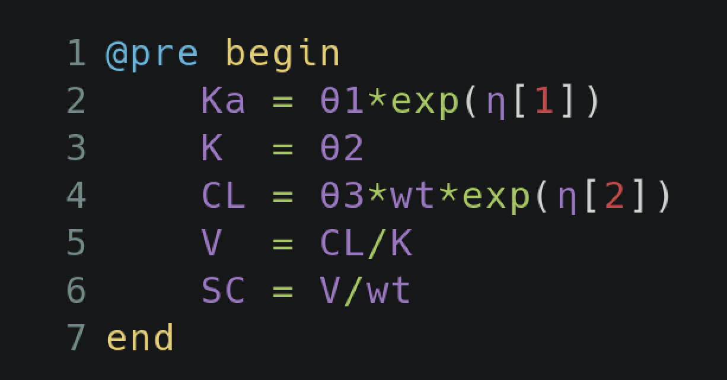
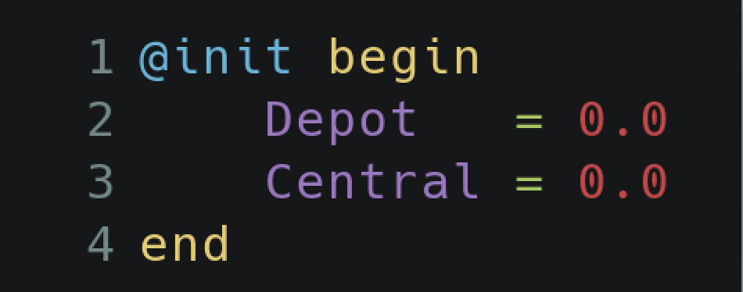
@pre: pre-processing
@pre begin
Ka = θ1 * exp(η[1])
K = θ2
CL = θ3*wt * exp(η[2])
V = CL / K
SC = V / wt
end
This determines how the model parameters, random effects and covariates are combined before the differential equations solver.
@init: Initial values (optional)
@init begin
Depot = 0.0
Central = 0.0
end
Specifies the starting values of the differential equations at the time of first dose.

Slide 10
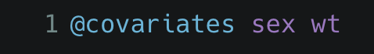
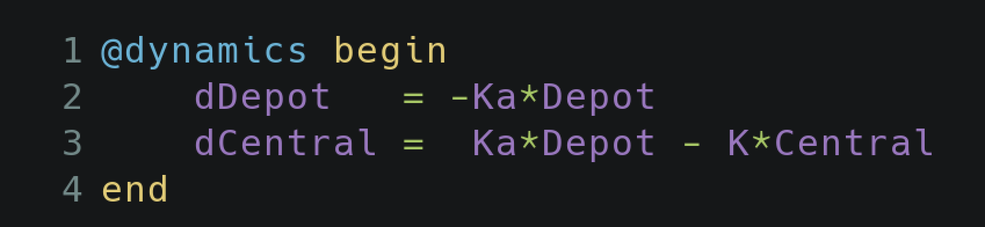
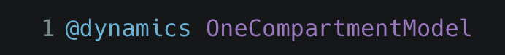
@covariates: Covariates
@covariates sex wt
Specifies the covariate terms from the dataset.
@dynamics: ODE specification
@dynamics begin
dDepot = -Ka*Depot
dCentral = Ka*Depot - K*Central
end
Specifies the system of differential equations. Differential variables are declared by having a line defining their derivative.
Also provide special cases for known closed-form solutions, e.g.
@dynamics OneCompartmentModel

Slide 11
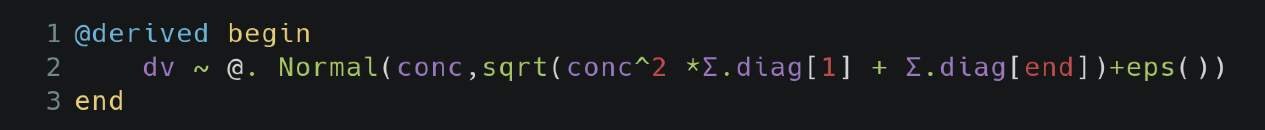
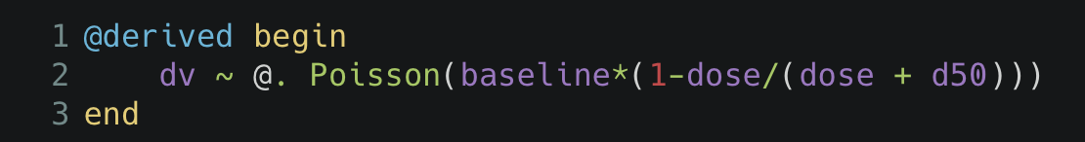
@derived: post-processing
@derived begin
dv ~ @. Normal(conc,sqrt(conc^2 *Σ.diag[1] + Σ.diag[end])+eps())
end
The derived block specifies variables that can be used for post-processing of results. It can be an continuous distribution shown above or a discrete one like
@derived begin
dv ~ @. Poisson(baseline*(1-dose/(dose + d50)))
end
Notes:
That covers the basics of how we can construct a NLME model in Pumas.
But how do we use these models?
How would I make decisions based on this model?

Slide 12
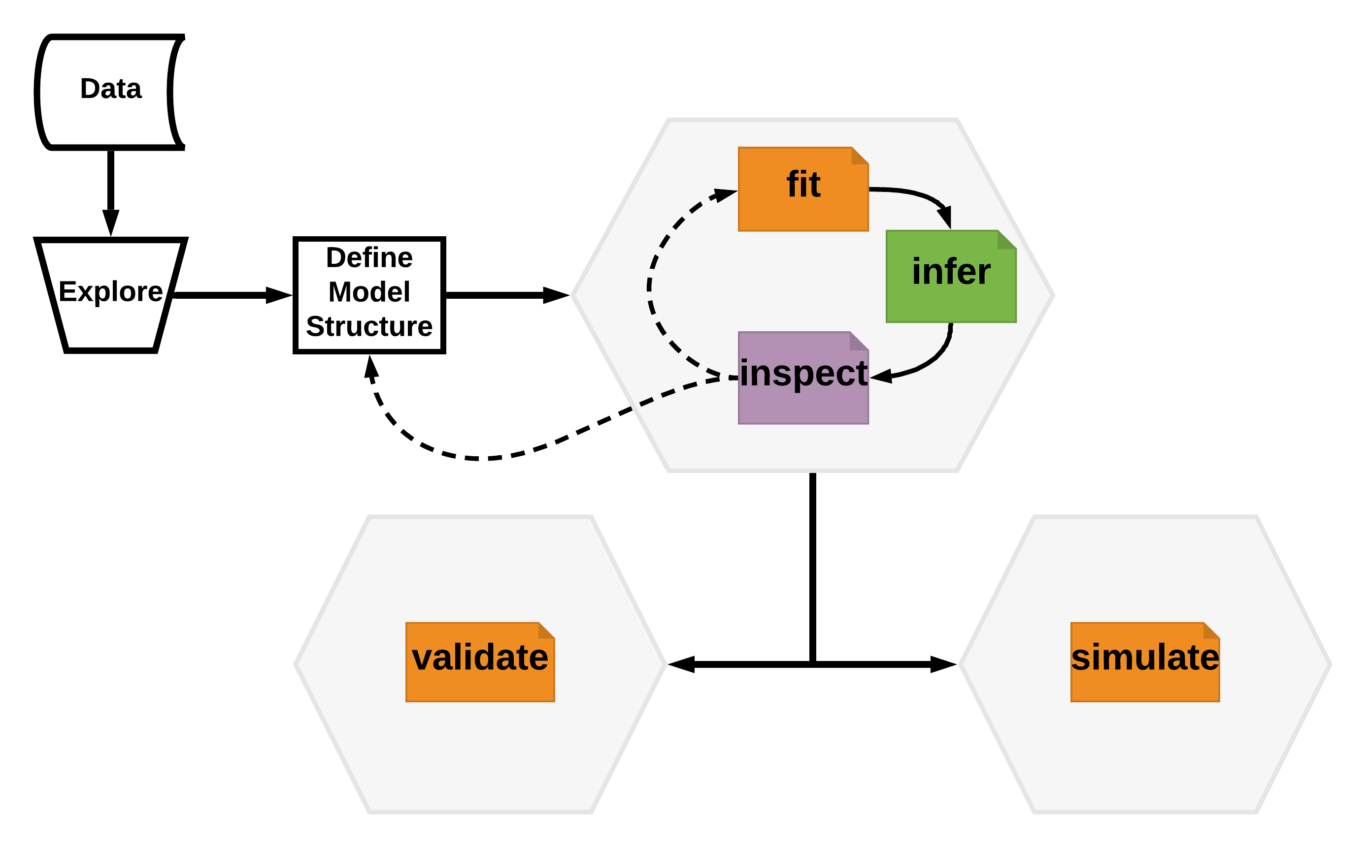
Notes:
The general workflow for NLME modelling looks something like this.
Like any data modelling you start with pre-processing and exploring the data. This can then be used to make assumptions about the parameters of the model and the general structure.
Next we define a model

Slide 13
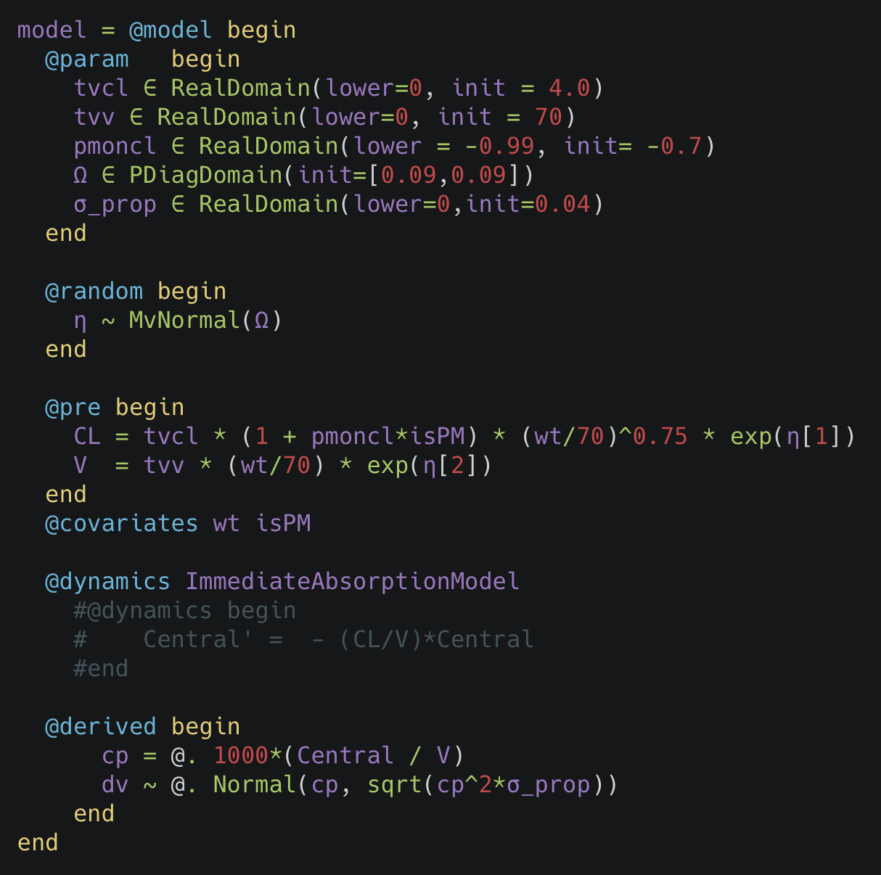
Define the model
m_diffeq = @model begin
@param begin
θ ∈ VectorDomain(7, lower=zeros(7), init=ones(7))
Ω ∈ PDiagDomain(2)
σ_prop ∈ RealDomain(init=0.1)
end
@random begin
η ~ MvNormal(Ω)
end
@pre begin
Ka = θ[1]
TVCL = isPM == "yes" ? θ[2] : θ[2]*θ[6]
CL = TVCL*exp(η[1])
V = θ[3]*exp(η[2])
lags = [0,θ[4]]
bioav = [1,θ[5]]
duration = [0,θ[7]]
end
@covariates isPM Wt
@dynamics begin
Depot' = -Ka*Depot
Central' = Ka*Depot - (CL/V)*Central
end
@derived begin
cp = @. 1000*(Central / V)
dv ~ @. Normal(cp, sqrt(cp^2*σ_prop))
end
end
Notes:
In the model we can define the parameters, their relationships, define what we want to be observing and so on.
But what then?

Slide 14
Let’s suppose that there was clinical trial for a new exciting drug JuliaCon, it relieves you of headaches due to using other languages.
We observed the concentrations but we did not see the response we wanted. We think that the dosage we were giving, say 100mg was not sufficient, we need to ramp it up.
The question arises, what if I increase the dose to say, 200mg, does that fix the problem? What about 150mg would that work?
To answer this question we would have to run the entire clinical trial again with these different doses.
That is slow and costs a lot!
So how do we answer this question?

Slide 15
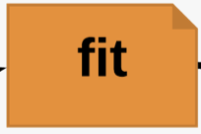
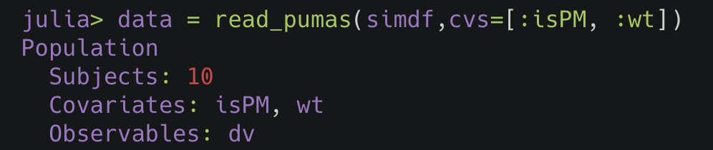
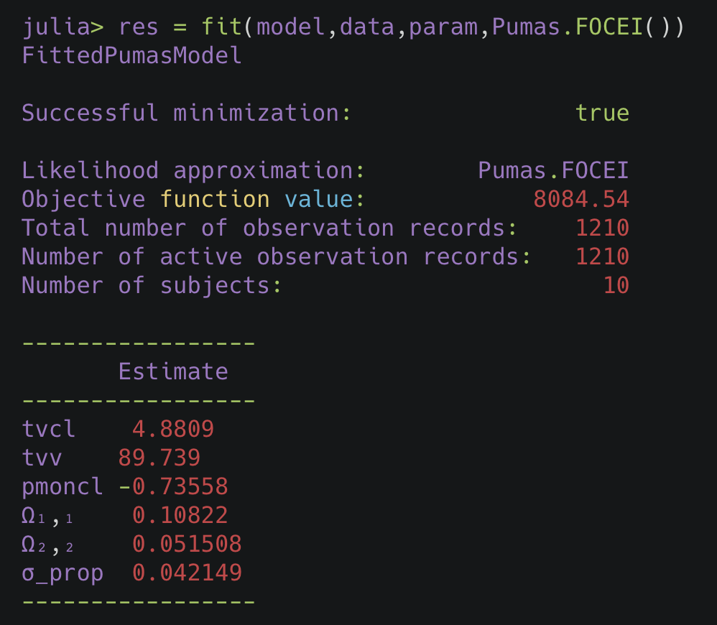
Fitting
Read the data
Use this data to estimate the parameters of our model.
https://docs.pumas.ai/dev/basics/estimation/#Maximum-Likelihood-Estimation-1
https://docs.pumas.ai/dev/basics/estimation/#Bayesian-Estimation-1
Notes:
Fitting is estimating of the parameters of the model that best describe the data.
This can be done by the maximum likelihood estimation, using such as Laplace or First order approximations or b a completely bayesian approach or using the stochastic approximation expectation maximisation algorithm.
From the fit function call we have the estimated parameters, but we want to know how accurate those estimates are, what are the errors involved and then do some more post processing of the result.

Slide 16
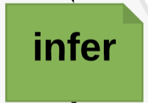
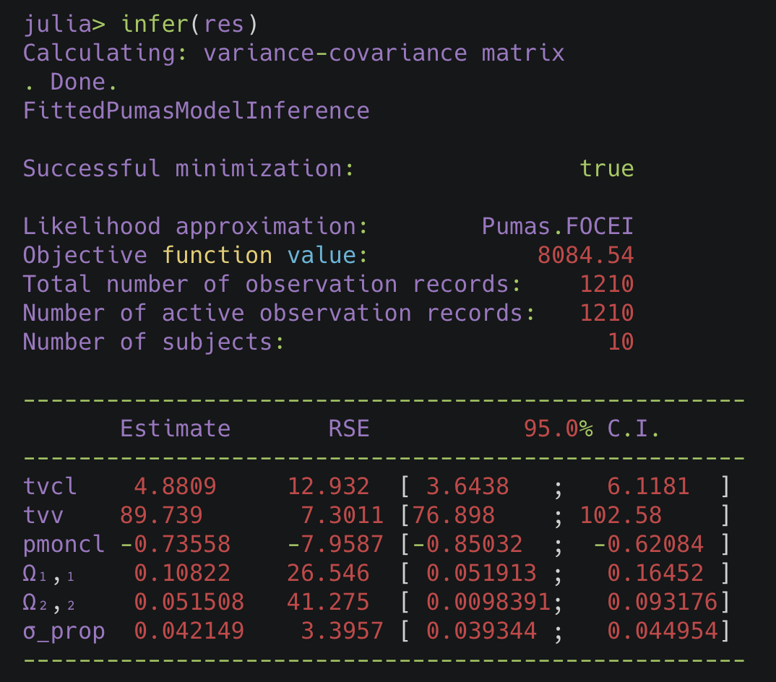
https://docs.pumas.ai/dev/analysis/diagnostics/#The-infer-Function-1
Notes:
From infer you can get the uncertainty involved in your parameter estimates, how good our parameter estimates are.
It gives the 95% confidence intervals and the relative standard errors for the estimates.
It is computing the covariance matrix of the population parameters and returns a `FittedPumasModelInference` object used for inference based on the fitted model `fpm`.

Slide 17

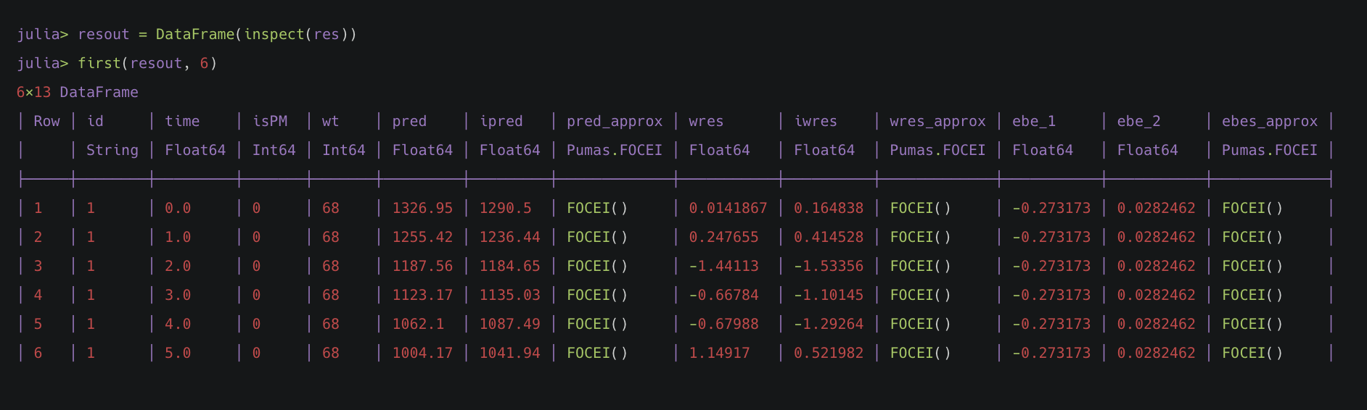
Predictions: The difference between the observations and the model expectation
Population - EPRED, PRED, CPRED, CPREDI
Individual - IPRED, CIPRED, CIPREDI, EIPRED
Residuals:
Population - NPDE, WRES, CWRES, CWRESI
Individual - IWRES, ICWRES, ICWRESI, EIWRES
ηshrinkage, ϵshrinkage, AIC, BIC
https://docs.pumas.ai/dev/analysis/diagnostics/#Model-Diagnostic-Functions-1
Notes:
inspect lets us assess if our model, given the estimated parameters fits the data well.
It gives the model predictions, residuals and Empirical Bayes estimates

Slide 18

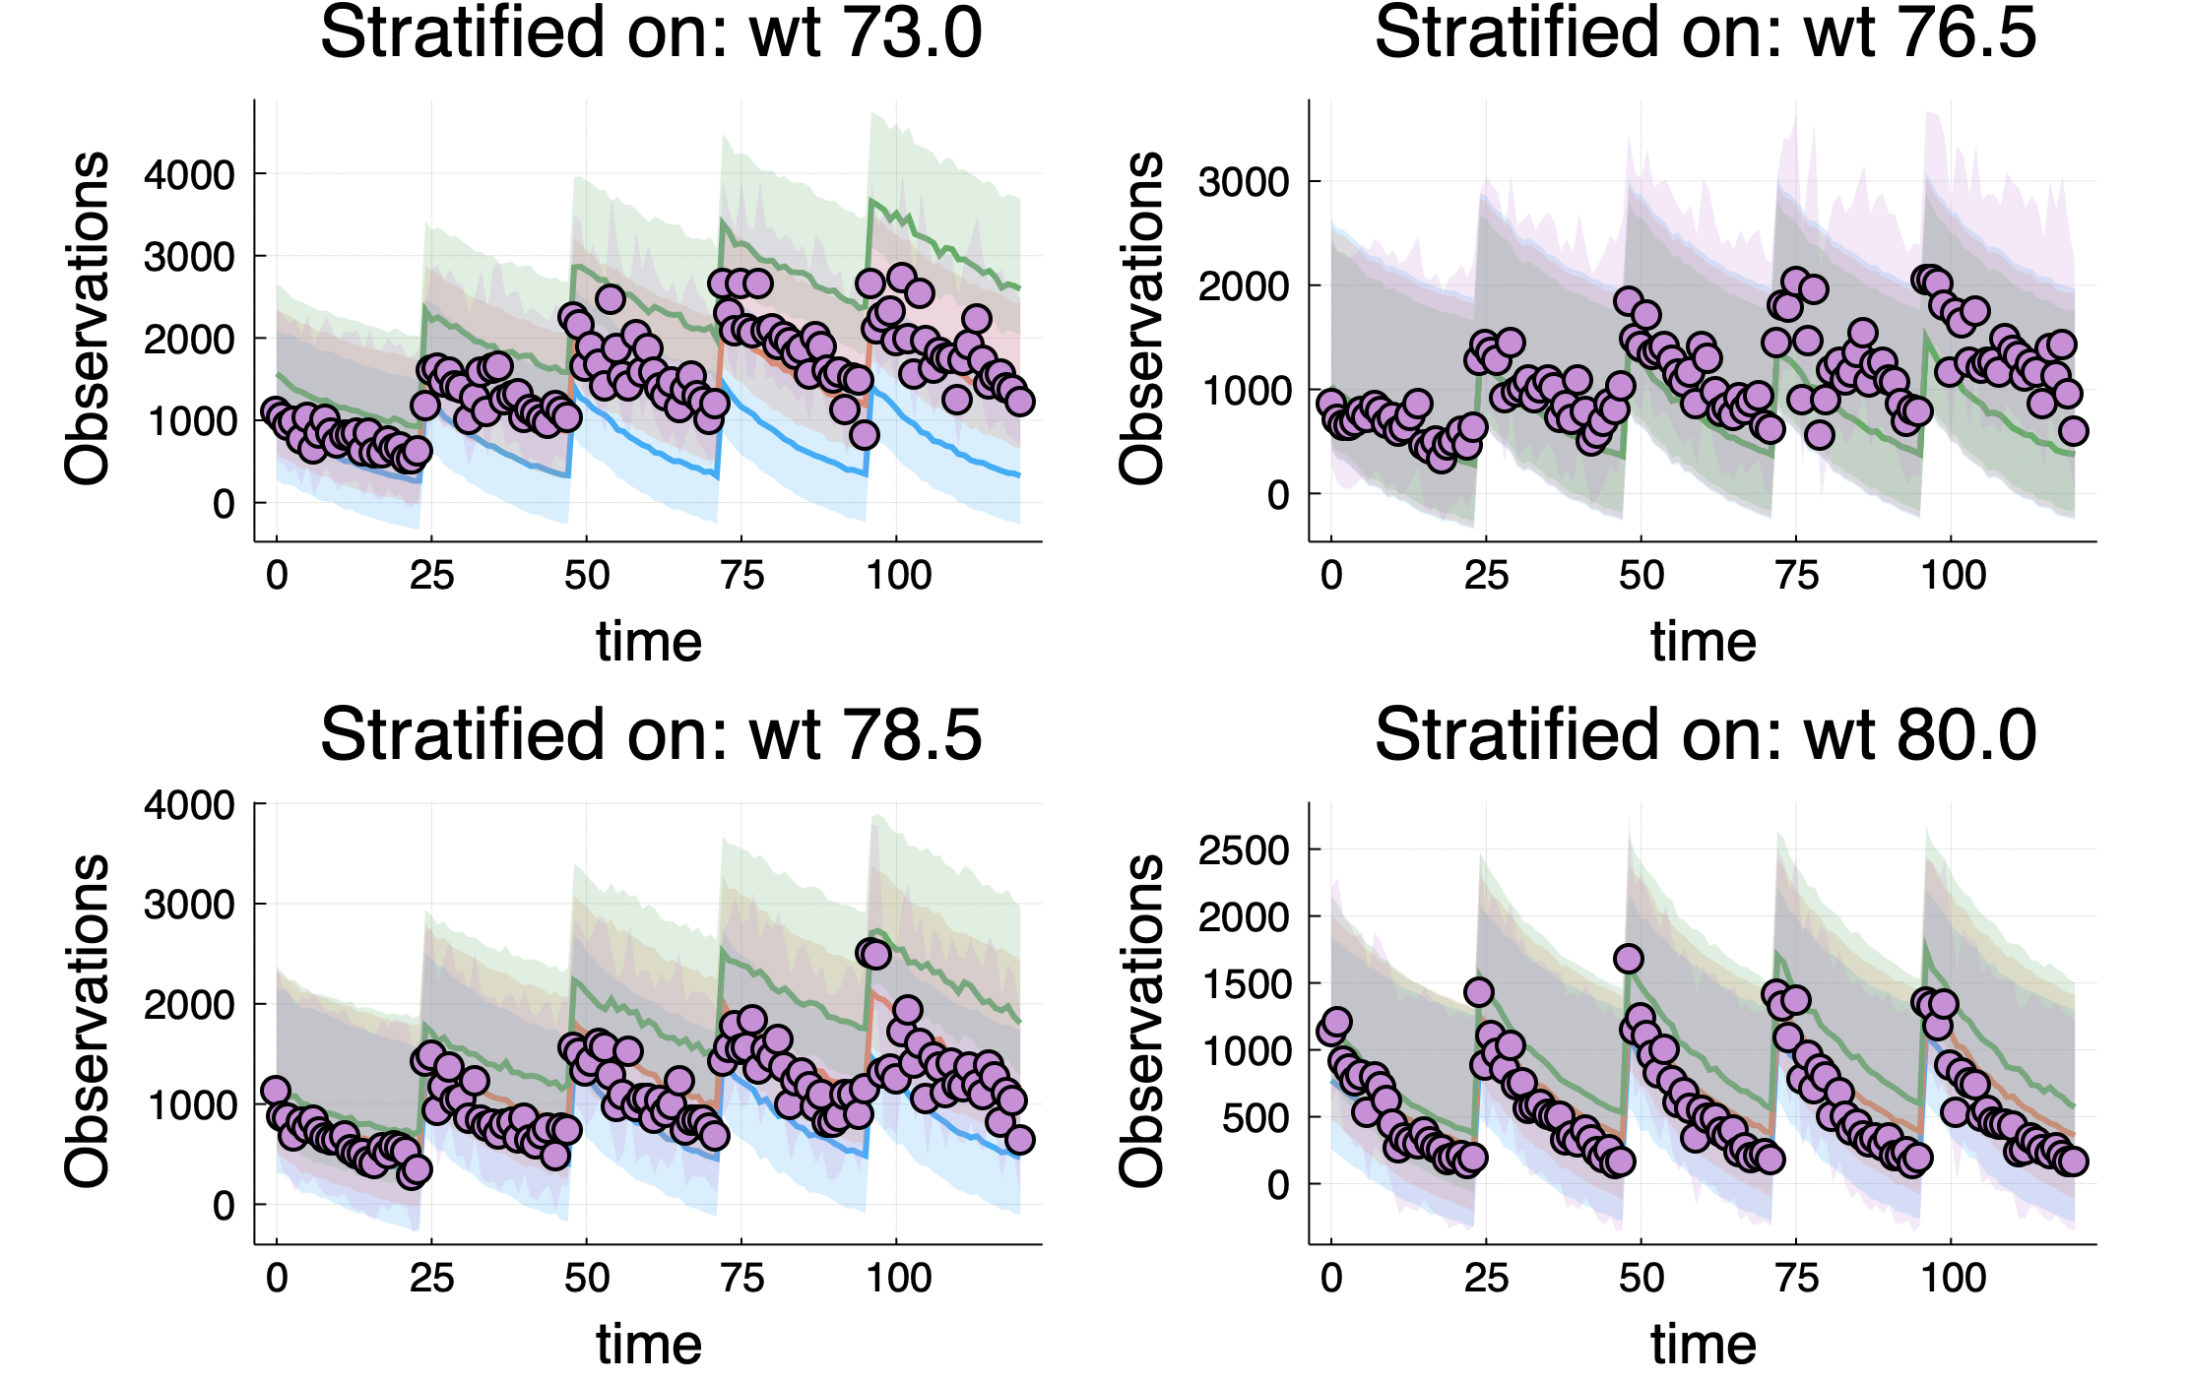
https://docs.pumas.ai/dev/analysis/diagnostics/#The-Visual-Predictive-Check-(vpc)-Function-1
Notes:
We can use the visual predictive check (VPC) for validation with respect to the data, basically it helps us to see how our model captures the data. Here we have a vpc plot of the 5th, 50th and 95th quantiles of the simulations with the data scattered on top of it.

Slide 19
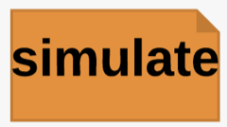
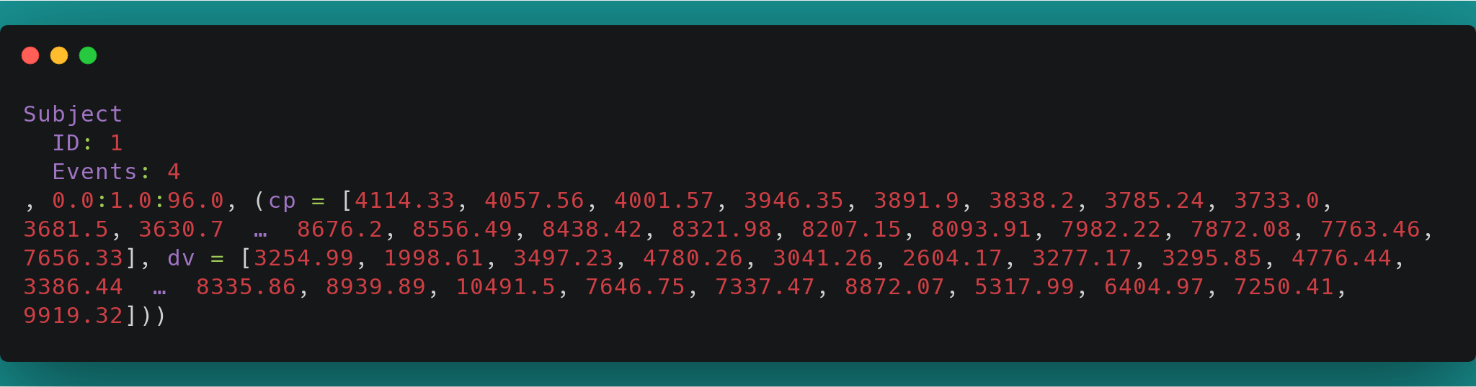
We run the simulation with a simobs call
julia> sim1 = simobs(m_diffeq, ev1, p; abstol=1e-14, reltol=1e-14)
The subject wise simulation output
Subject
ID: 1
Events: 4
, 0.0:1.0:96.0, (cp = [4114.33, 4057.56, 4001.57, 3946.35, 3891.9, 3838.2, 3785.24, 3733.0, 3681.5, 3630.7 … 8676.2, 8556.49, 8438.42, 8321.98, 8207.15, 8093.91, 7982.22, 7872.08, 7763.46, 7656.33], dv = [3254.99, 1998.61, 3497.23, 4780.26, 3041.26, 2604.17, 3277.17, 3295.85, 4776.44, 3386.44 … 8335.86, 8939.89, 10491.5, 7646.75, 7337.47, 8872.07, 5317.99, 6404.97, 7250.41, 9919.32]))
https://docs.pumas.ai/dev/basics/simulation/#Simulation-of-Pumas-Models-1
Notes:
The main function for running a simulation is `simobs`. `simobs` on a population
simulates all of the population (in parallel), while `simobs` on a subject
simulates just that subject. If we wish to change the parameters from the
initialized values, then we pass them in. Here is the output for the first subject, it has the solution as the dv and cp variables over time that we declared in the derived block

Slide 20
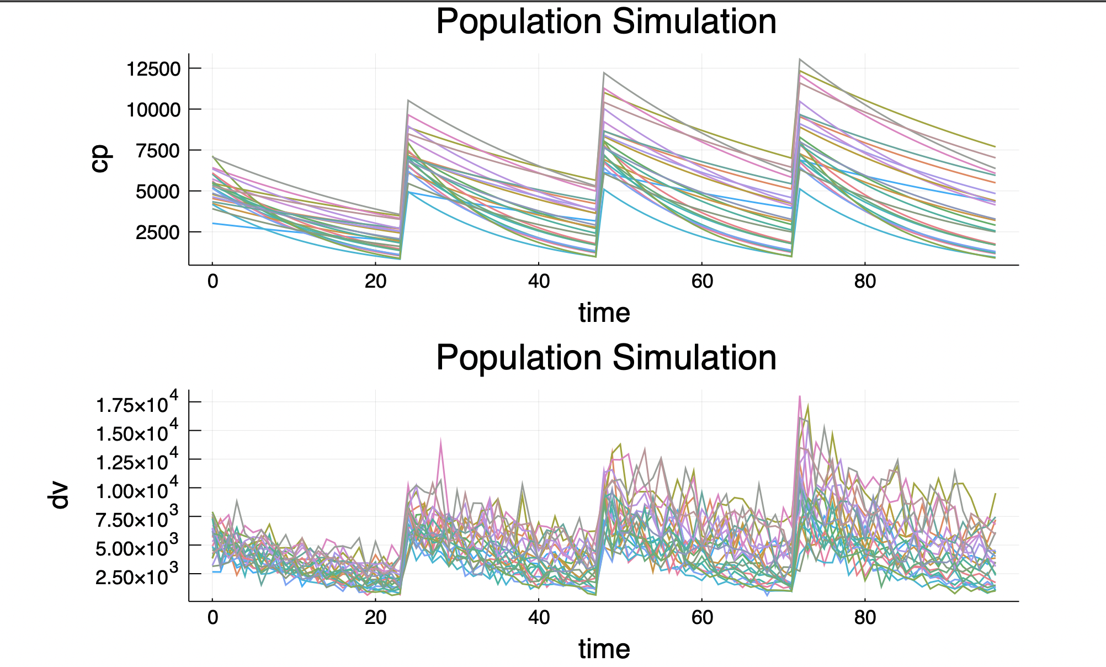
julia> plot(sim1)

Slide 21
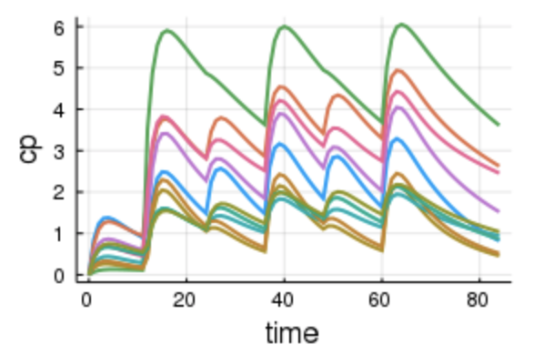
To answer the question, just change the dosage regimen and plug it into the simobs function to simulate different scenarios.

Slide 22
Acknowledgments
Vijay Ivaturi
Chris Rackauckas
Andreas Noack
Patrick Mogensen
Joga Gobburu
JC Bangalore Team
Simon Byrne
Notes:
So at the end, I would like to express my gratitude towards all the people that I have had the opportunity to work with in Pumas, Chris, Vijay, Andreas, Patrick, Joga, Simon and also the awesome team at Julia Computing Bangalore office where I spent the summer.
Thank you.

Slide 23
Notes:
Designed for 2 questions
Pharma developers simulate and estimate ct data

